Slide 1
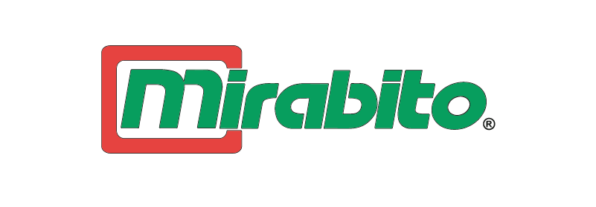

Customer Value & Basket Insights For Strategic Promotion at Mirabito
Presented By
Andrew Brown, Michael Dua, Madison Gennaro, Habiba Jannat, Snehal Wadile, Gavin Wentzel

Slide 2
Agenda
Project Overview
Data Processing
Descriptive Results
Basket Analysis & CLV Segmentation Results
Summary of Key Findings and Recommendations

Slide 3
Project Objective
Goal of the Analysis
To uncover meaningful customer purchase patterns and segment behavior across loyalty groups in order to inform data-driven marketing and inventory decisions at Mirabito.
Why This Matters
  Enables targeted promotions based on actual shopping behavior
  Helps optimize product bundling and shelf placement strategies
  Supports loyalty program refinement by identifying high-value customer segments
  Maximizes revenue opportunities through smarter cross-sell and upsell tactics

Slide 4
Data Processing

Slide 5
Data Cleaning
Integrated and standardized transaction-level data from multiple Excel sources using Transaction ID as the unique key.
Key variables extracted for analysis:
Transaction ID (unique visit identifier)
Customer PK (anonymized customer key)
Item IDs purchased per transaction
Item category and loyalty program associated
Quantity purchased and retail price
Derived fields created to enable deeper analysis:
Revenue per line item = Quantity × Retail Price
Customer Lifetime Value (CLV): calculated and tiered for segmentation
CLV Tier: defined as High, Medium, and Low for personalized insights.
Time frame limited to May 22–28, 2025, due to Excel row constraints, ensuring a clean and consistent snapshot for analysis.

Slide 6
Data Cleaning
Integrated and standardized transaction-level data from multiple Excel files
using Transaction_ID as the primary key.
Filtered timeframe to May 22–28, 2025, ensuring a consistent and manageable dataset snapshot.
Replaced invalid or ambiguous values:
  Item Category value -1 reassigned as "Fuel"
  Ensured no missing values in key analytical fields
Selected key fields for analysis:
  Transaction_ID, Customer_PK, Item_IDs, Quantity, Retail_Price
  Item_Category, Loyalty_Program, Transaction_Date
  Datasets Used: POS_TRANSACTION_DETAIL_FACT, POS_PAYMENT_METHOD_DIM, POS_PAYMENT_DETAILS2_FACT
Created derived fields to support deeper insights:
  Item_Revenue
  CLV and CLV_Tier for segmentation

Slide 7
Data Overview

Slide 8
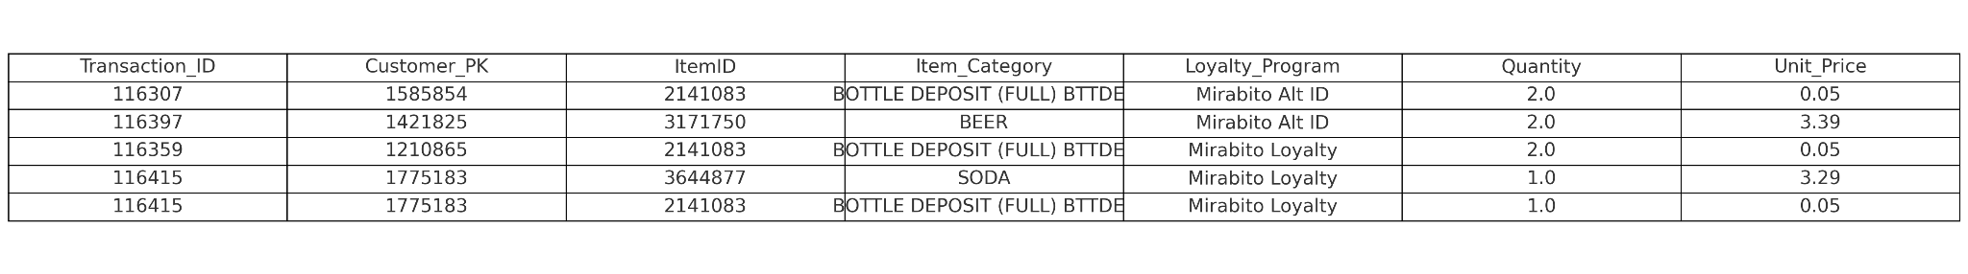
Raw Data Description
Observation Unit:
Each row represents a single customer transaction
Key Variables:
Transaction_ID : Unique visit identifier
Customer_PK : Anonymized customer key
Item_IDs : Items purchased per transaction
Item_Category & Loyalty_Program : Product type and associated customer loyalty program
Quantity & Retail_Price : Purchase volume and item cost per transaction

Slide 9
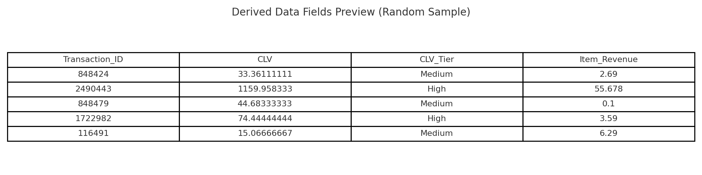
Derived Data Description
Derived Fields:
Revenue per Line Item : Calculated as Quantity × Retail Price
Customer Lifetime Value (CLV) : Calculated metric used to represent long-term customer value, based on purchase frequency and average spend
CLV_Tier : Categorization of customers into High, Medium, and Low value tiers for personalized analysis

Slide 10
Loyalty Segmentation & Revenue Summary

Slide 11
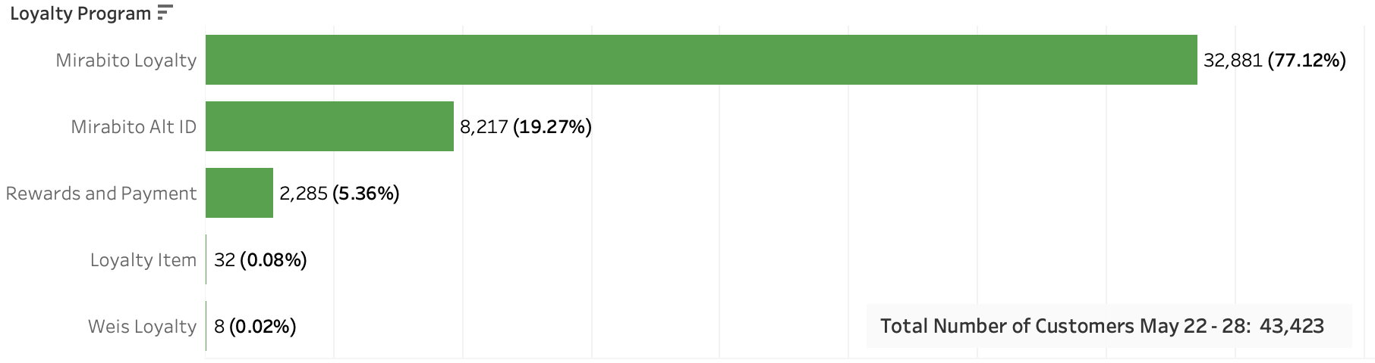
Customer Breakdown by Loyalty Program
Mirabito Loyalty is the primary program, with 77% of customers
Alt ID and Rewards & Payment together account for about 24% of customers
Loyalty Item and Weis Loyalty together make up less than 1%

Slide 12
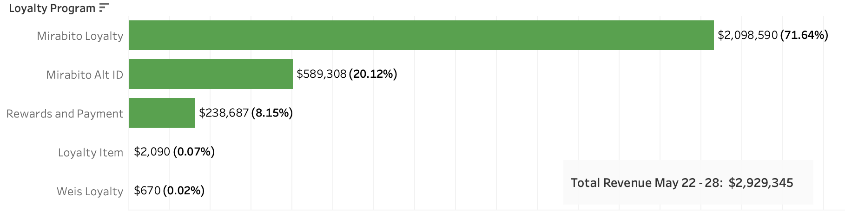
Distribution of Revenue Across Loyalty Groups
Mirabito Loyalty generates the majority of total revenue ($2.1M, 72% of sales).
Alt ID and Rewards & Payment account for about 28% of revenue combined.
Loyalty Item and Weis Loyalty contribute minimal revenue overall

Slide 13
Average Revenue per Customer by Loyalty Group
Rewards and Payment customers spend the most per person ($104.46 on average).
Mirabito Loyalty has the largest customer base but the lowest average spend ($63.82).
Understanding these differences highlights where to focus loyalty and upsell strategies.
Loyalty Program | Avg Revenue per Customer
Mirabito Loyalty | $63.82
Mirabito Alt ID | $71.72
Rewards & Payment | $104.46
Loyalty Item | $65.32
Weis Loyalty | $83.74

Slide 14
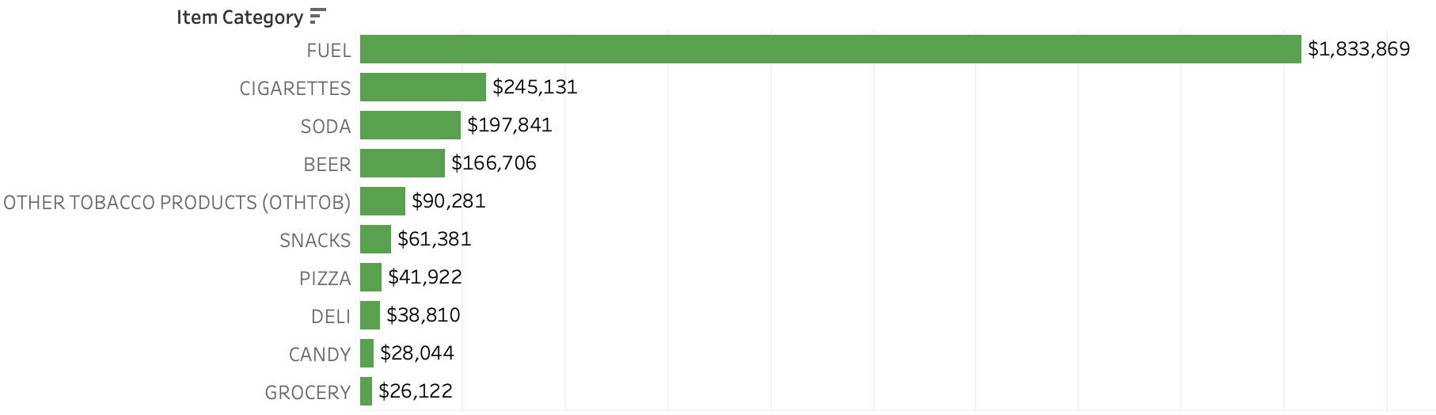
Top 10 Product Categories by Revenue (May 22-28)
Fuel generates the highest revenue by far, over $1.8M in one week.
Cigarettes, soda, and beer are the next largest revenue drivers.
Food, snacks, and grocery categories contribute moderate revenue compared to fuel.

Slide 15
Basket Analysis

Slide 16
Introducing Basket Analysis
A machine learning algorithm based on conditional probability.
  Conditional probabilities: based on X, then Y.
  Apriori + FP Growth
Using this methodology, we could analyze co-purchasing patterns
  Our approach: co-purchasing patterns by customer segment.
  We segmented by Loyalty Program and CLV.
Analysis goal: discover best-selling product-bundles.
  Decision-making criteria:
    Support
    Confidence
    Lift
Implications
  Underlying pattern recognition could lead to segment-based promotion
  Potential inventory downsizing/re-allocation

Slide 17
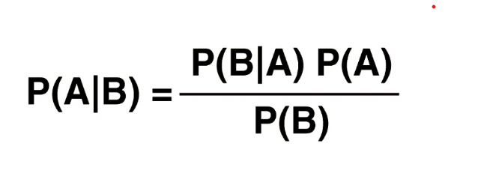
Functionality of Basket Analysis
FP Growth creates “trees” from patterns in data to make mining results more apparent.
Apriori sets a threshold for support as decision criteria to determine significant itemsets.
Foundation set in Conditional Probability
Notes:
to store transactions efficiently and skip over combinations that can’t possibly be frequent.
These itemsets are then used to generate association rules, which you measure with support, confidence, and lift.
Apriori generates candidate itemsets at each step, which can be computationally expensive for large datasets

Slide 18
Criteria Metrics
Support = Frequency of itemsets throughout the dataset.
Confidence = Likelihood of an item being purchased when another item is purchased.
Lift = Random chance of a standalone item versus how often it is purchased when another item is purchased (derived from the two previous metrics).
Notes:
Confidence = (Transactions with X and Y) / (Transactions with X)
How much more likely customers are to buy Y when they buy X, compared to buying Y randomly.
Formula:
Lift = Confidence / (Support of Y)

Slide 19
CLV- Customer Lifetime Value
Derived metric for customer value.
Originally meant for Customer PK’s but adapted for transactions.
CLV = (Average Spend per Visit × Purchase Frequency) / (Churn Rate + Discount Rate)
Churn Rate=Amount of customers that stop purchasing products
Churn Rate and Discount Rate derived using industry averages. (3% for Churn Rate and 6% for the discount rate)

Slide 20
Association Patterns by CLV Segment

Slide 21
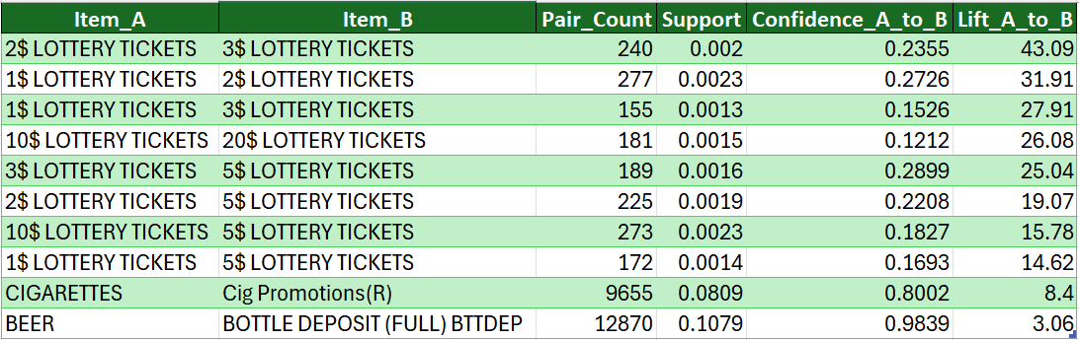
Top 10 Overall Items Association Rules (Support, Confidence, Lift)
🔹 Strong cross-buying behavior among lottery ticket denominations (1$, 2$, 3$, 5$, 10$, 20$)
🔹 Top rule: 2$ → 3$ Lottery Tickets has 43× lift, meaning it’s highly predictive
🔹 High pair counts confirm real, frequent customer behavior
🔹 Cigarettes → Promotions and Beer → Deposit show over 80–98% confidence
🔹 Ideal for bundling, upselling, and in-store promotions.

Slide 22
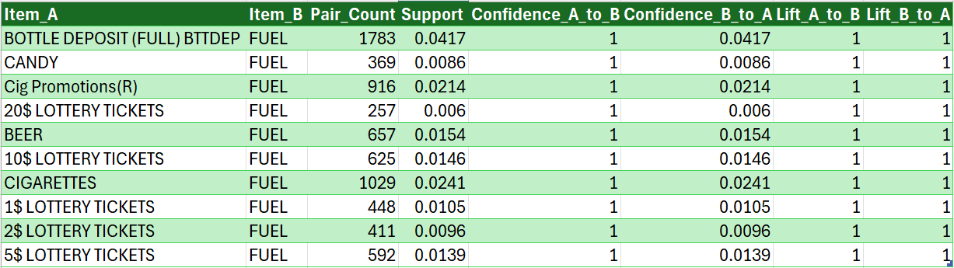
Top 10 Association Rules – Fuel Basket
🔹 All 10 rules show 100% confidence – fuel was always purchased with these items.
🔹 Bottle deposit, cigarettes, and candy are top fuel-linked products by volume.
🔹 Multiple lottery ticket types (1$–20$) appear consistently with fuel purchases.
🔹 Despite high confidence, lift = 1 for all rules → behavior is expected, not surprising.
🔹 Fuel acts as a central anchor in many shopping baskets.
🔹 These insights support placement of small-ticket impulse items near fuel pay points.

Slide 23
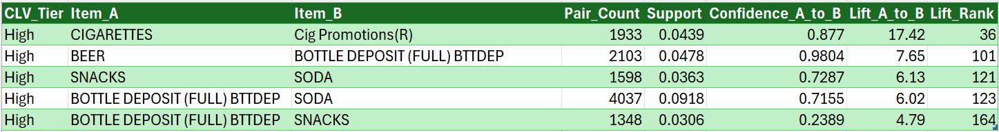
High CLV Tier – Premium Customer Association Patterns
🔹Key Points:
High CLV customers show very strong lift and confidence.
Top pairs:
  CIGARETTES → Cig Promotions (Lift: 17.4, Confidence: 87.7%)
  BEER → Bottle Deposit (Lift: 7.65, Confidence: 98.0%)
High support values indicate frequent, reliable patterns.
🔹Business Takeaway:
Target high-value customers with cigarette promos, beer-deposit bundles, and soda/snack combos.
Use loyalty apps or exclusive fuel offers to retain these customers.

Slide 24
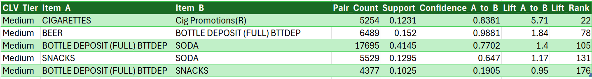
Medium CLV Tier – Solid Core Behavior
🔹 Key Points:
Consistent purchasing of beer + deposits, cigarette promotions, and soda.
Lift and confidence remain strong but slightly lower than High tier.
This group is responsive to routine product positioning.
🔹 Business Takeaway:
Reinforce in-store layouts with trusted bundles.
Push mid-tier customers toward high-tier with reward programs.

Slide 25
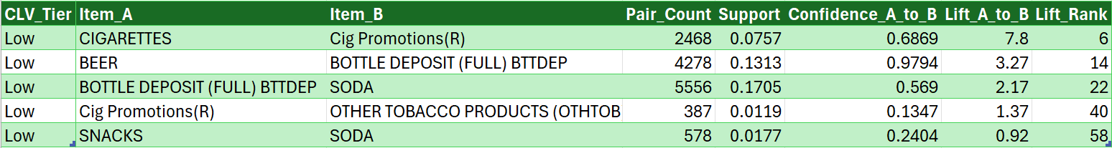
Low CLV Tier – Impulse or Essentials Focus
🔹 Key Points:
Lower lift and confidence, but higher support (volume).
Popular pairs: Bottle Deposit + Soda, Cigarettes + Promotions (still strong)
Often fuel-related or single-purpose shopping trips.
🔹 Business Takeaway:
Use these behaviors to trigger entry-level promotions (e.g., Buy 1, Get 1).
Encourage multi-item baskets to increase CLV.

Slide 26
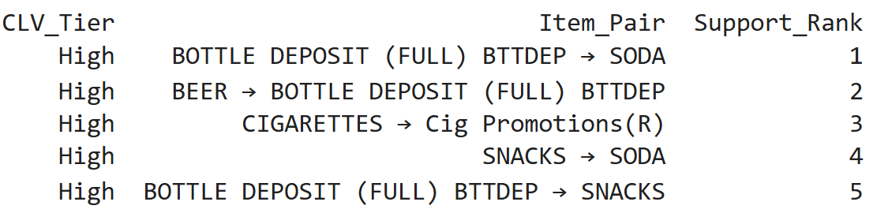
Products associated with “High” CLV
Using machine learning, we broke up items into sets given importance by support.
After deriving CLV, we broke up the distribution into Tiers: Low, Medium and High.
Based on High Values, best-selling itemsets are:

Slide 27
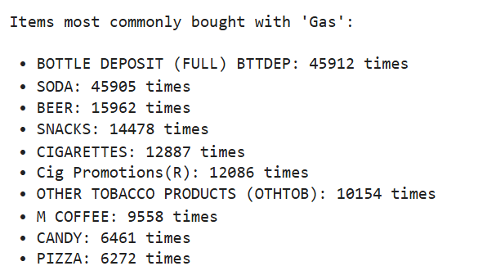
Most likely purchases given a customer buys “Gas”
Items grouped with gas tend to be mostly “road trip” items.
Customers most often redeemed bottle deposits.
Possible promotions can derive from this: Pizza and Soda, Pizza and Snacks, etc.
Deals can be loyalty program specific.

Slide 28
Top Frequent Itemsets by Customer Segments

Slide 29
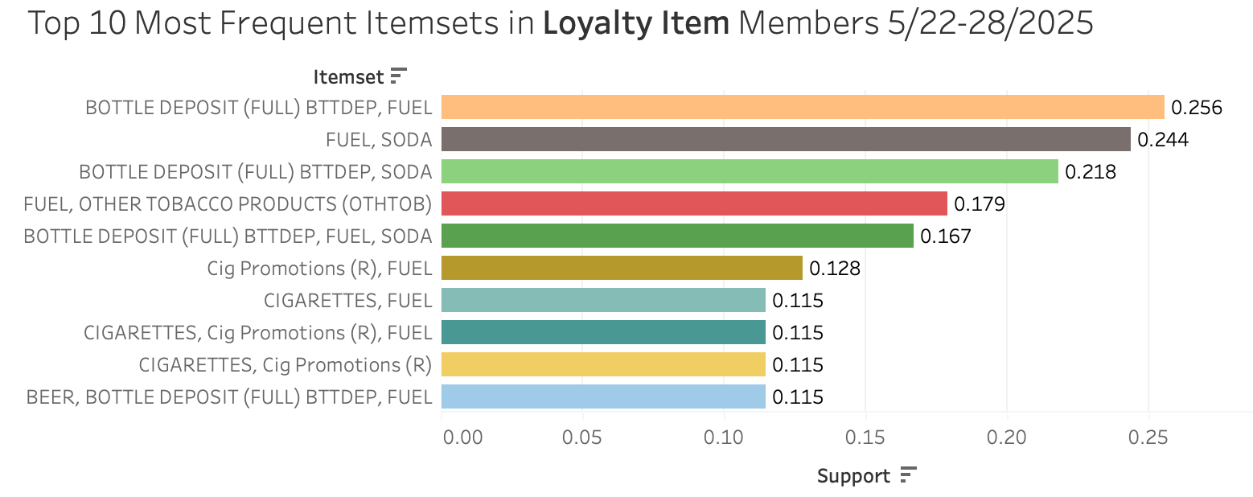

Slide 30
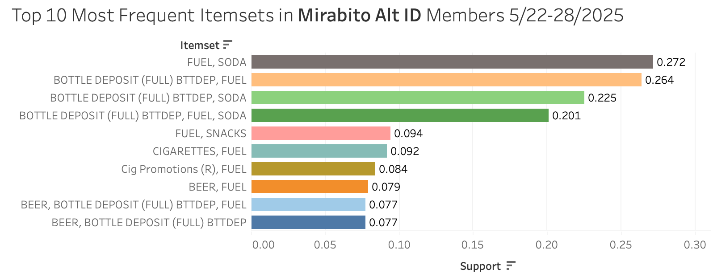

Slide 31
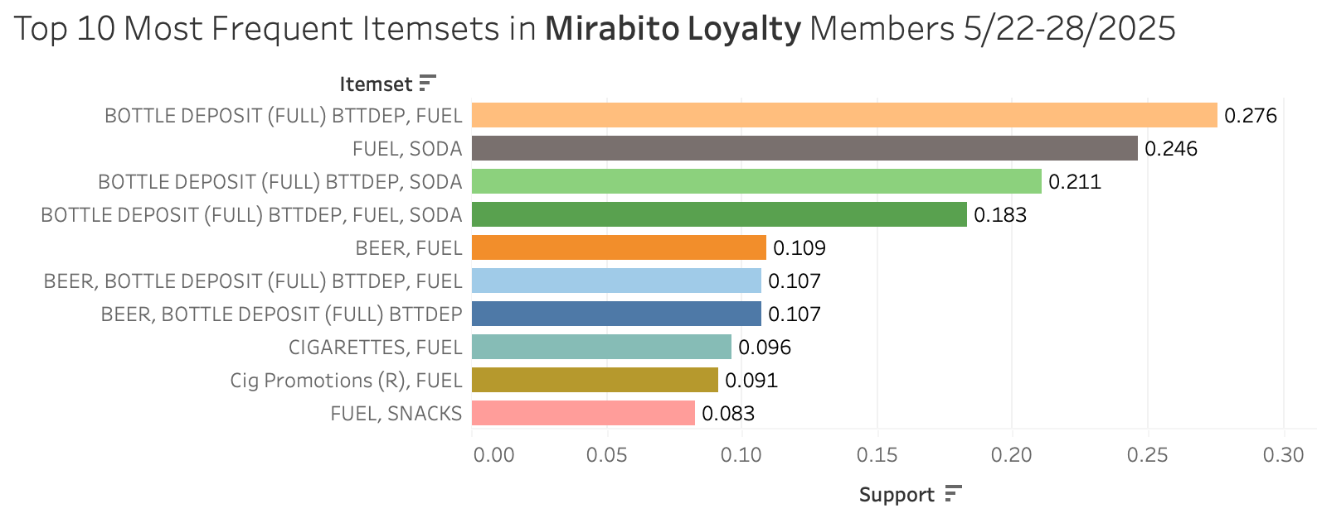

Slide 32
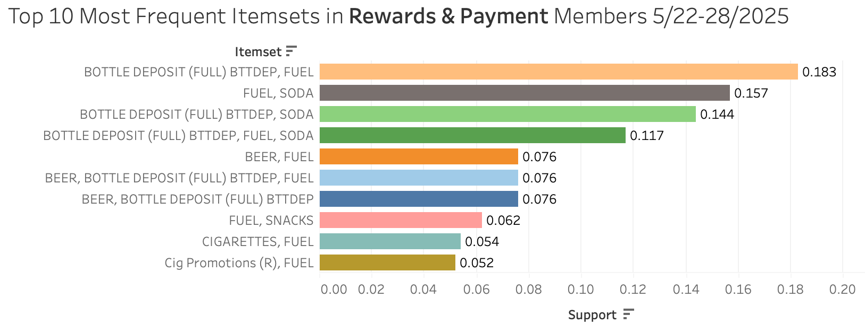

Slide 33
Key Findings & Recommendations

Slide 34
Findings & Recommendations
🛒 Group purchases often involve junk food, soda, and lottery — ideal for bundled promotions.
🚭 Reduce cigarette inventory in locations with fewer loyalty customers.
🧃 Streamline grocery offerings due to low revenue contribution.
Loyalty Program Insights
Mirabito Loyalty has the most members (77%) but the lowest avg. spend per customer.
Rewards & Payment members spend ~$104 each, the highest per capita.
➤ Boost Mirabito spend through upsells; retain high-value Rewards & Payment users.

Slide 35
Findings & Recommendations(Cont’d)
Product Bundling Opportunities
Common pairings: Lottery + Soda, Cigarettes + Promotions, Gas + Pizza/Soda.
➤ Design targeted bundles and loyalty-triggered offers.
Cross-Sell Opportunities
Gas purchases frequently co-occur with Pizza, Soda, and Bottle Deposit
➤ Introduce “Road Trip” bundles targeting gas buyers, with personalized offers by loyalty group.
Customer Value Strategy
High CLV users show strong co-purchase rules (e.g., Cigarettes → Cig Promo, Lift = 17.4).
➤ Use CLV tiers to personalize promotions and maximize lifetime value.

Slide 36
Pitfalls & Future Work

Slide 37
Pitfalls
🔍 Data Limitations
Analysis was based on a narrow timeframe (one week) and single region, limiting generalizability.
Data quality gaps: Missing or ambiguous values (e.g., category -1) required assumptions.
No integration of seasonal or external variables (e.g., holidays, promotions).
📉 Modeling Limitations
CLV segmentation used pre-calculated tiers; no predictive modeling applied.
Transaction analysis relied on unique item counts, ignoring purchase quantity or item margin.
Did not account for time-based behavior (e.g., time of day, weekday vs. weekend patterns).

Slide 38
Future Work
🚀 Future Enhancements:
Incorporate transaction quantity and margin data for better product-level insights.
Explore revenue-based segmentation and dynamic CLV prediction models.
Identify cyclical trends by expanding to multi-week or seasonal data.
Develop personalized recommendations using item affinity and loyalty group behavior.
Use cluster analysis for discovering alternative customer segments.

